Slide 1
Data Science Unit-III
Multivariant Analysis
From: Edouard Duchesnay, Tommy Lofstedt and Feki Younes, ”Statistics and Machine Learning in Python”, online

Slide 2
Multivariant Analysis
Multivariate analysis encompasses all statistical techniques that are used to analyze more than two variables at once.
The aim is to find patterns and correlations between several variables simultaneously—allowing for a much deeper, more complex understanding of a given scenario than you’ll get with bivariate analysis.
There are three categories of analysis to be aware of:
Univariate analysis, which looks at just one variable: Bar charts, Pie charts, Histograms
Bivariate analysis, which analyzes two variables, Ex: Scatter plot, Regression and Correlation anlysis
Multivariate analysis, which looks at more than two variables Ex: Clustering etc

Slide 3
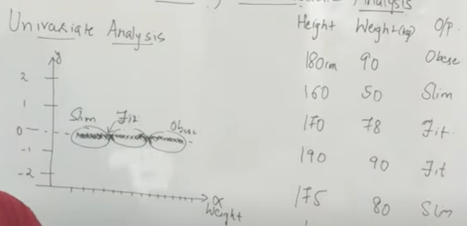
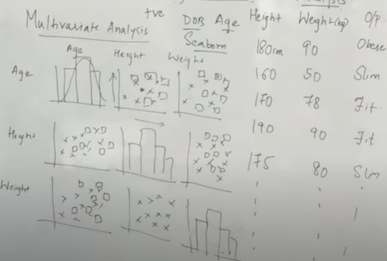
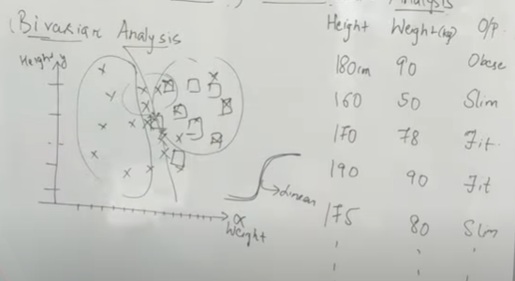
Univariate, Bivariate & Multivariate Analysis
Used Seaborn
Correlation plays major role = +ve, -ve, 0 values

Slide 4
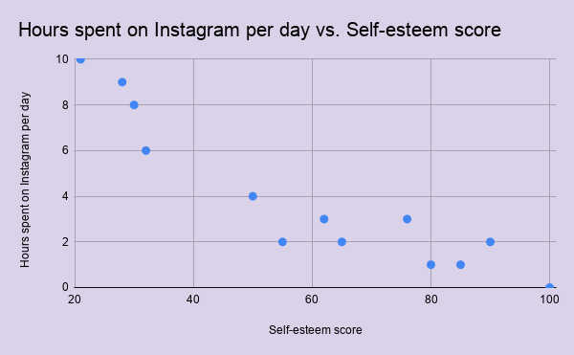
Need of Multivariant Analysis
How many hours a day a person spends on Instagram
Their self-esteem score (measured using a self-esteem scale)
You may or may not find a relationship between the two variables; however, you know that, in reality, self-esteem is a complex concept.
You might also want to consider factors such as age, employment status, how often a person exercises, and relationship status (for example)
Need Multivariant Analysis.

Slide 5
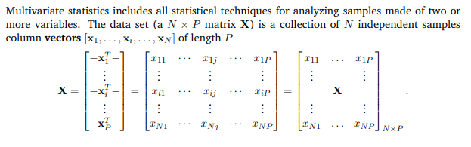
Multivariant Statistics

Slide 6
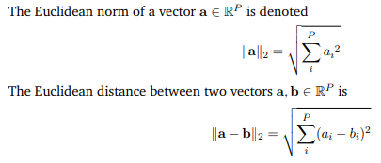
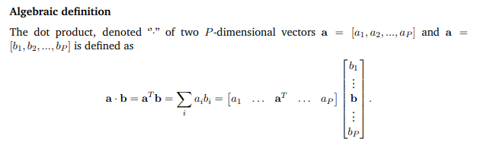
Linear Algebra: Euclidean norm and distance, Dot product and projection

Slide 7
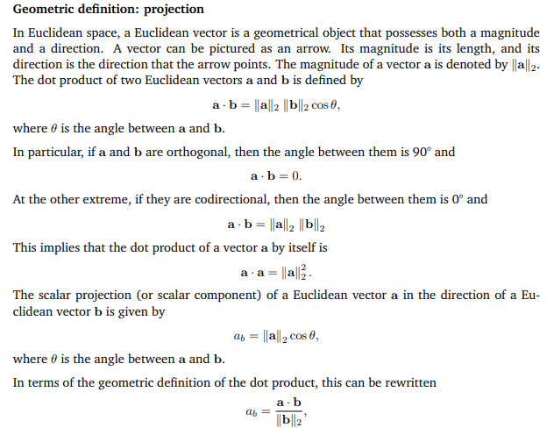
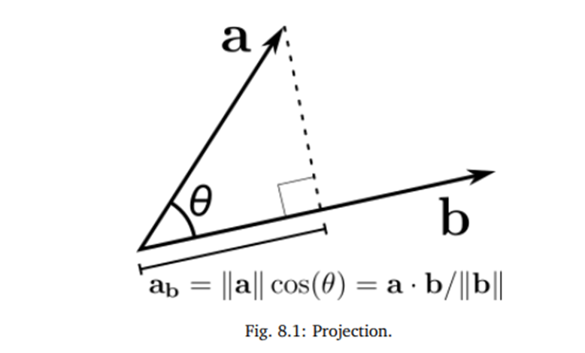
Dot product and projection

Slide 8
Linear Algebra: Vector Arithmetic
Vectors in data science
A vector is a tuple of one or more values called scalars. Vectors are built from components, which are ordinary numbers. We can think of a vector as a list of numbers, and vector algebra as operations performed on the numbers in the list.
Vectors are often represented using a lowercase character such as “v”;
For example: v = (v1, v2, v3) Where v1, v2, v3 are scalar values, often real values.
For example, if we have the heights, weights, and ages of many people, we can treat our data as three-dimensional vectors (height, weight, age). If we’re teaching a class with four exams, we can treat student grades as four-dimensional vectors (exam1, exam2, exam3, exam4).
Vector space: A space comprised of vectors, collectively with the associative and commutative law of addition of vectors and also the associative and distributive process of multiplication of vectors by scalars is called vector space

Slide 9
Vector Arithmetic:
The vector operations are comfortable in which the vectors are same dimension space. The result of the operations is either vector or scalar. The basic vector operations are defined in n-dimensional vectors u=(u1,u2,…,un), v=(v1,v2,…,vn), w=(w1,w2,…,wn) and a scalar s as follows:
Addition : w=u+v =>(w1,w2, …,wn)= (u1+v1, u2+v2, …, un+vn)
Subtraction: w=u-v =>(w1,w2, …,wn)= (u1-v1, u2-v2, …, un-vn)
Multiplication: w=u*v =>(w1,w2, …,wn)= (u1*v1, u2*v2, …, un*vn)
Division: w=u/v =>(w1,w2, …,wn)= (u1/v1, u2/v2, …, un/vn)
Scalar and Vector Multiplication:
w=s*u=s*(u1,u2,…,un)=>(w1,w2,…,wn)=(s*u1,s*u2,…, s*un).
Vector dot product: s = u.v =>(w1,w2, …,wn)= u1*v1+u2*v2+ …+ un*vn

Slide 10
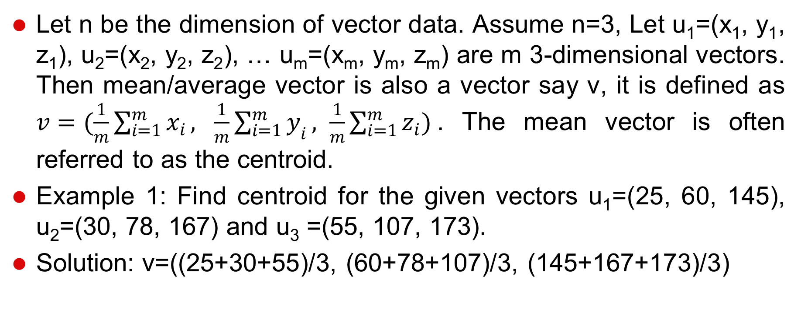
Mean Vector: Definition

Slide 11
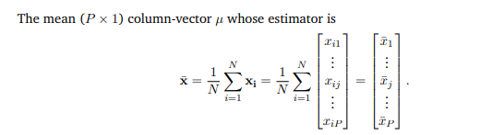
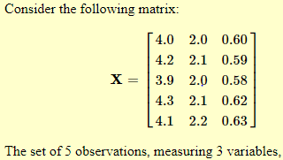
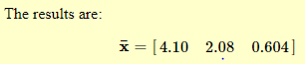
Mean vector

Slide 12
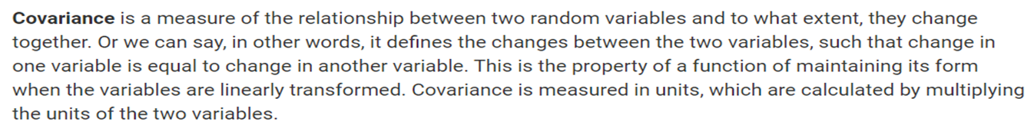
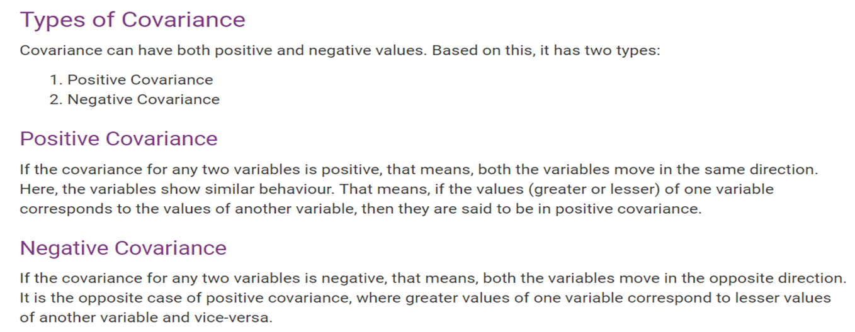
Covariance and Correlation

Slide 13
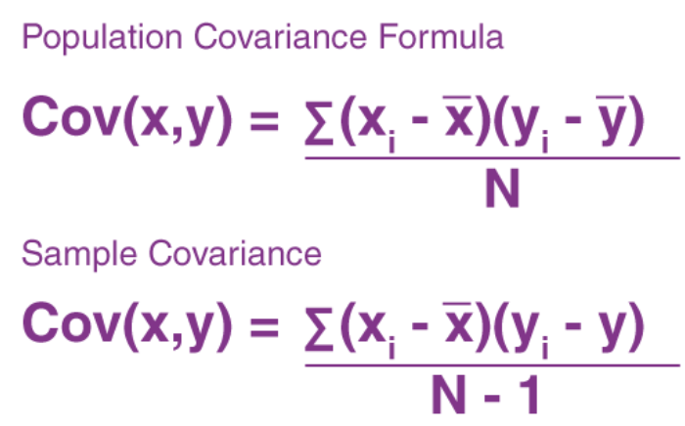
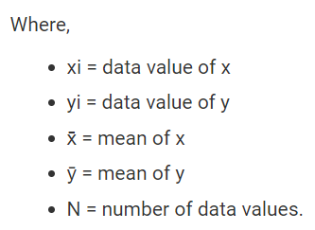
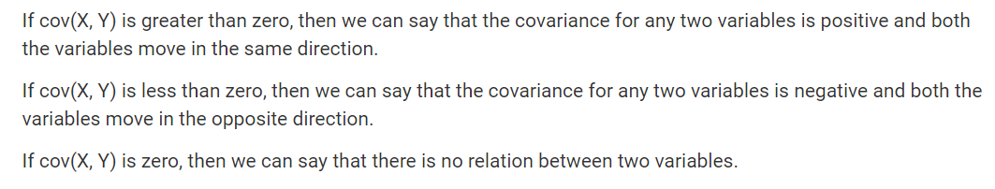

Slide 14
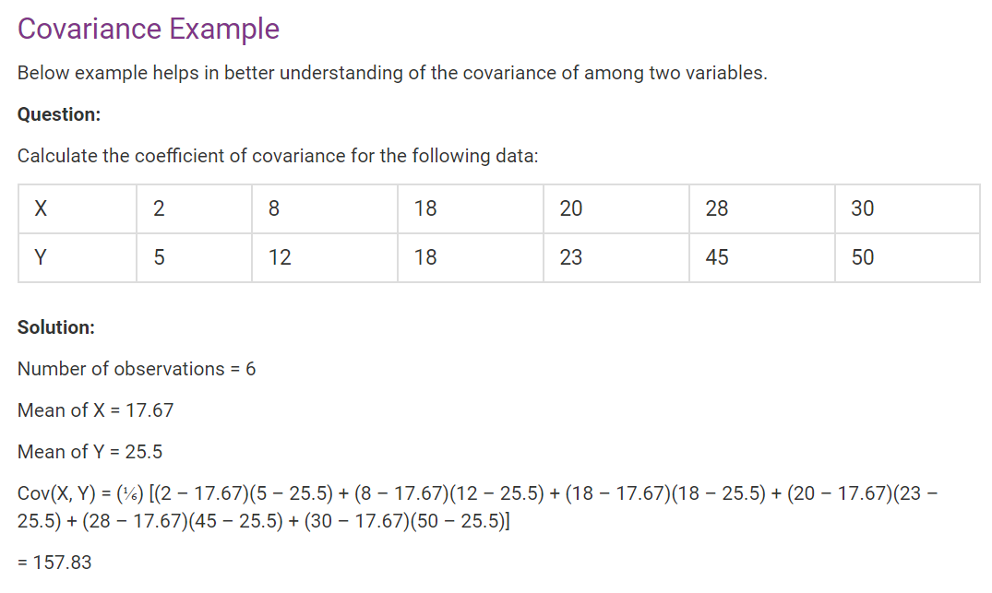

Slide 15
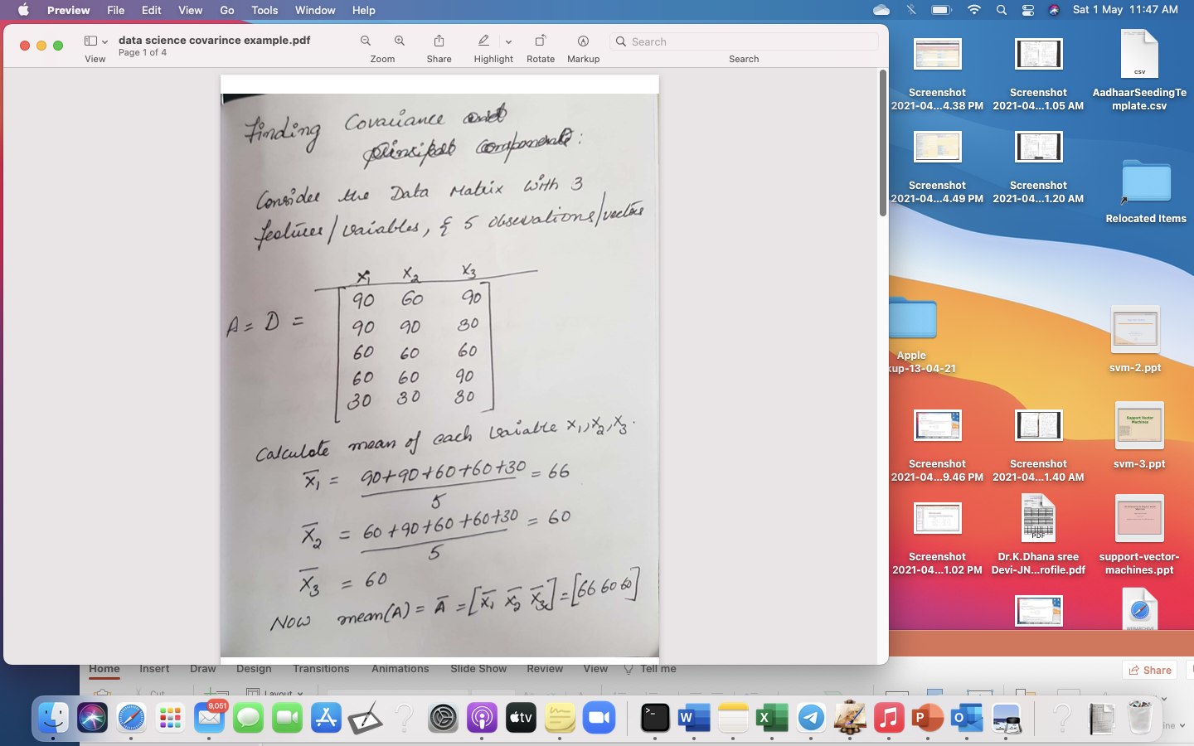
Example :

Slide 16
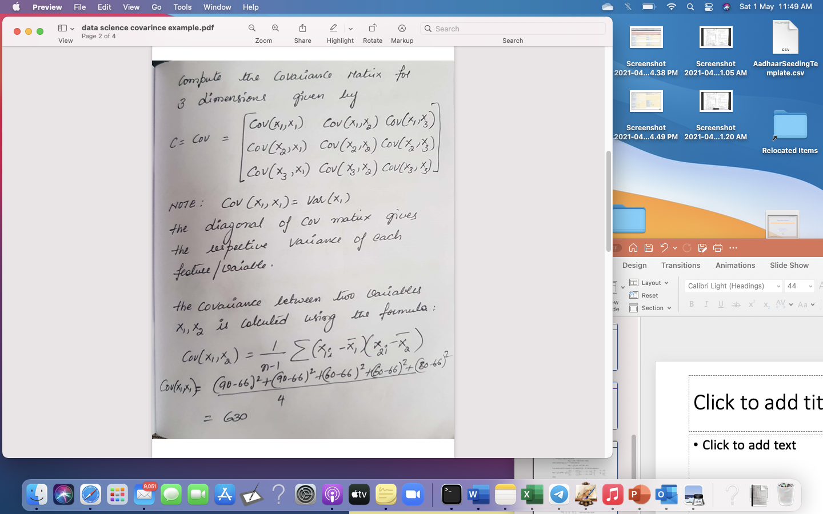

Slide 17
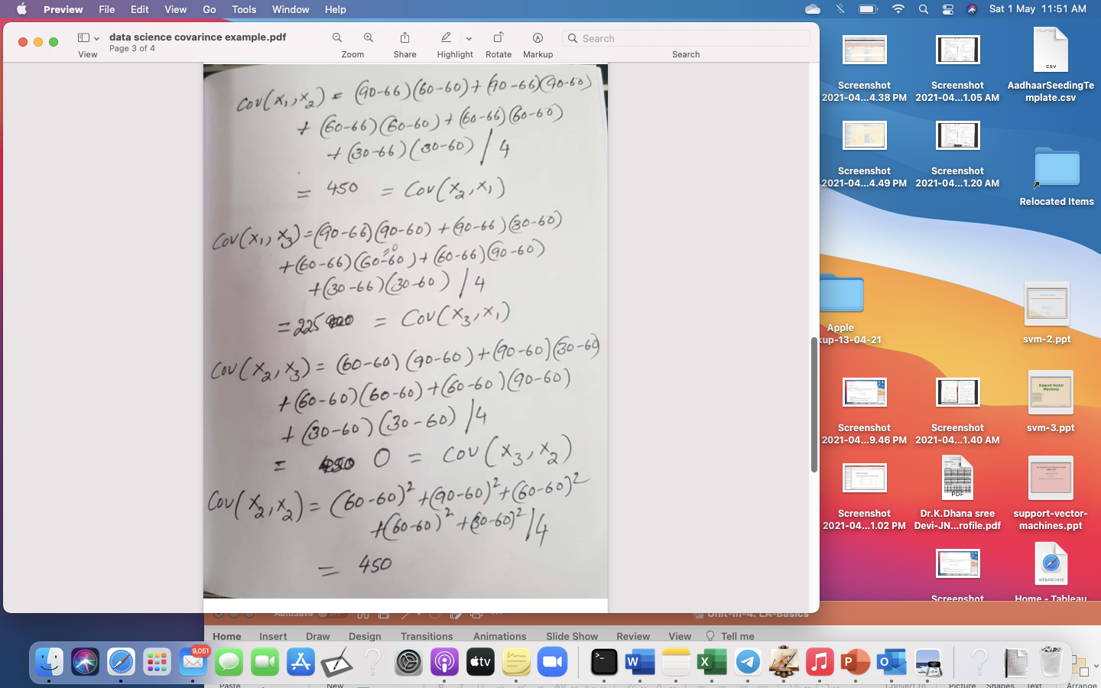

Slide 18
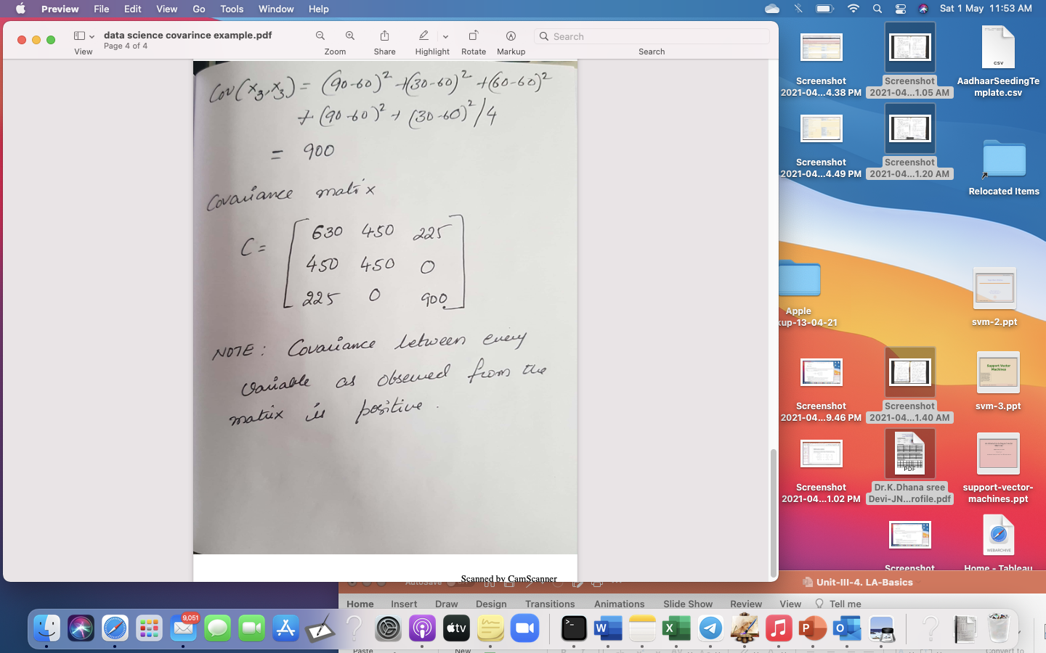

Slide 19
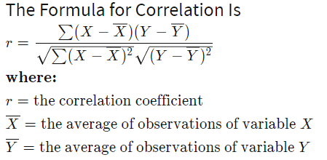
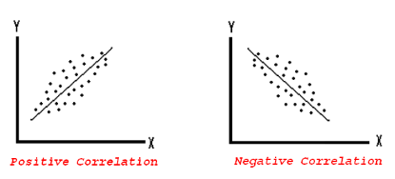
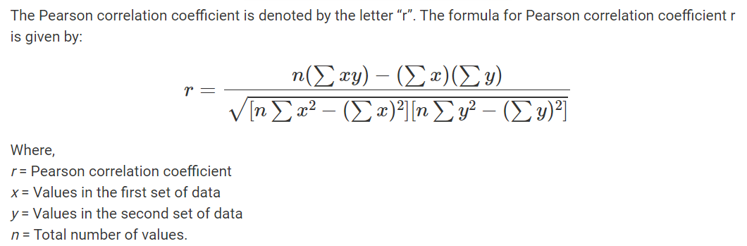
Correlation
Correlation analysis is a method of statistical evaluation used to study the strength of a relationship between two, numerically measured, continuous variables.
Computed as Correlation co-efficient
Value ranges between – (-1) to (+1)
Positively Correlated, Negatively correlated, Not correlated
The strength of a correlation indicates how strong the relationship is between the two variables. The strength is determined by the numerical value of the correlation

Slide 20
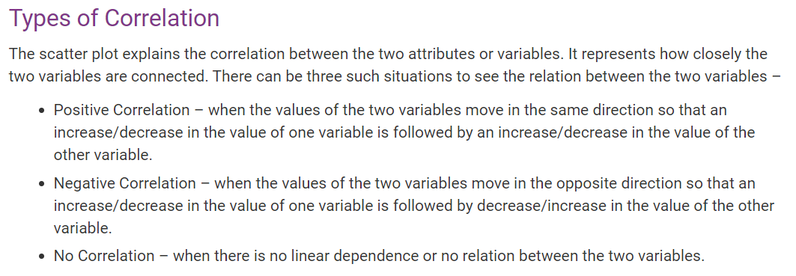

Slide 21
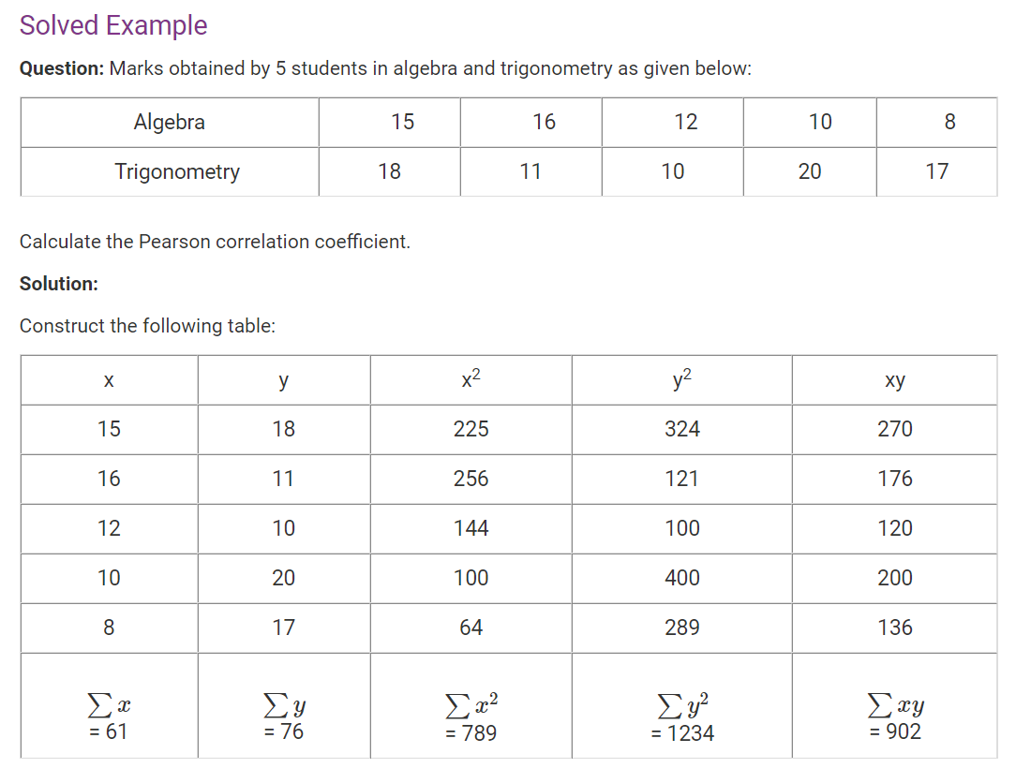
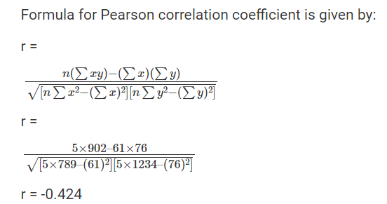

Slide 22
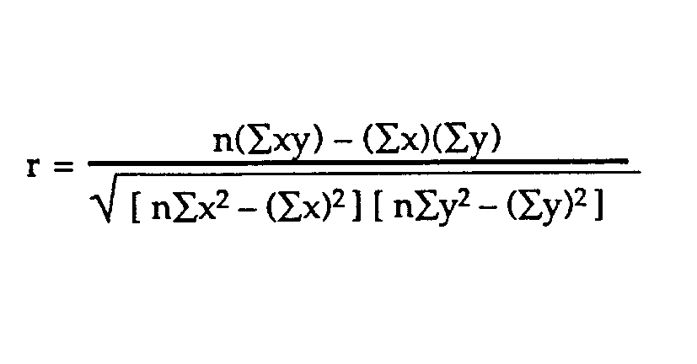
Example problem:
Business problem: The healthcare industry want to develop a
medication to control glucose levels. For this it want to study does age
have impact on raise in glucose levels
SUBJECT | AGE X | GLUCOSE LEVEL Y | XY | X² | Y²
1 | 43 | 99 | 4257 | 1849 | 9801
2 | 21 | 65 | 1365 | 441 | 4225
3 | 25 | 79 | 1975 | 625 | 6241
4 | 42 | 75 | 3150 | 1764 | 5625
5 | 57 | 87 | 4959 | 3249 | 7569
6 | 59 | 81 | 4779 | 3481 | 6561
Σ | 247 | 486 | 20485 | 11409 | 40022
From our table:
Σx = 247
Σy = 486
Σxy = 20,485
Σx² = 11,409
Σy² = 40,022
n is the sample size=6
The correlation coefficient =
6(20,485) – (247 × 486) / [√[[6(11,409) – (247²)] × [6(40,022) – 486²]]]. = 0.5298 (strength and direction)
The range of the correlation coefficient is from -1 to 1.
here result is 0.5298 or 52.98%, which means the variables have a moderate positive correlation( some what more ). We cant infer with 52.98% correlation that age has impact on rise in glucose levels. We need more data to analyze

Slide 23
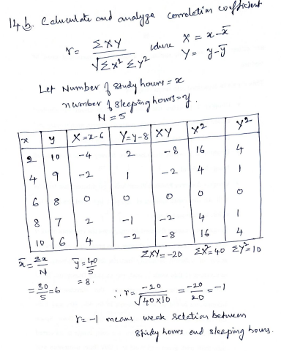

Slide 24
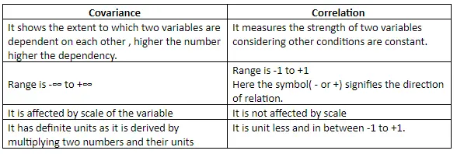
Covariance vs Correlation

Slide 25
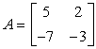
Precision Matrix: More generally
.
The precision matrix of a random vector is the inverse of its covariance matrix.
If A is the covariance matrix the precision matrix is given by
P=A⁻¹
Find the inverse of the 2×2 covariance matrix below A, if it exists

Slide 26
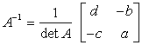
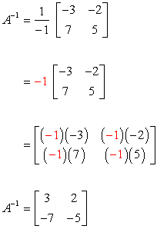
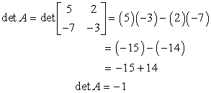
Its inverse is calculated using the formula

Slide 27
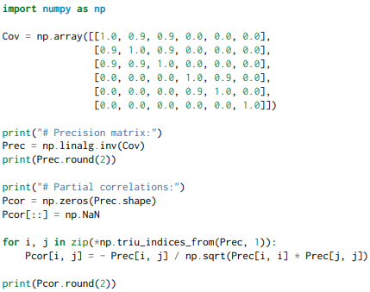
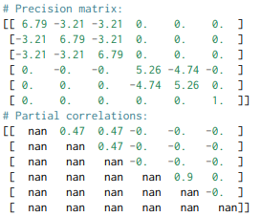
Precision matrix Evaluation Metrics
In statistics, precision is the reciprocal of the variance, and the precision matrix is the matrix inverse of the covariance matrix.
It is related to partial correlations that measures the degree of association between two variables, while controlling the effect of other variables

Slide 28
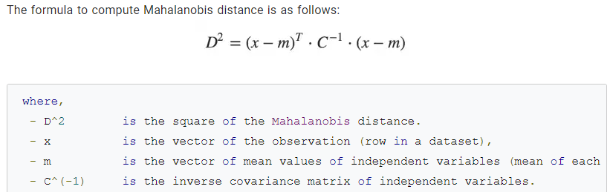
Mahalanobis distance
Mahalanobis distance is an effective multivariate distance metric that measures the distance between a point and a distribution. It is an extremely useful metric having, excellent applications in multivariate anomaly detection, classification on highly imbalanced datasets and one-class classification.

Slide 29
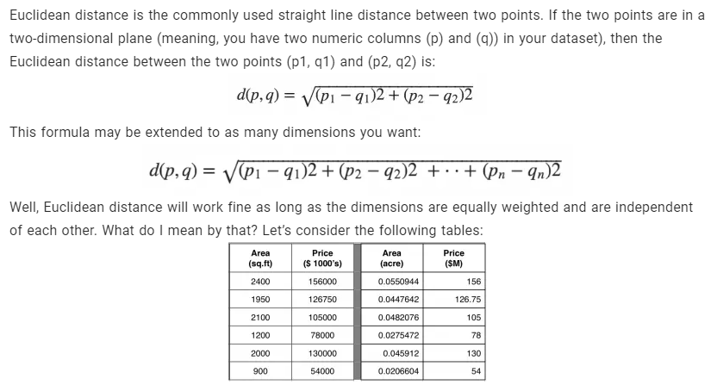
What’s wrong with using Euclidean Distance for Multivariate data?

Slide 30
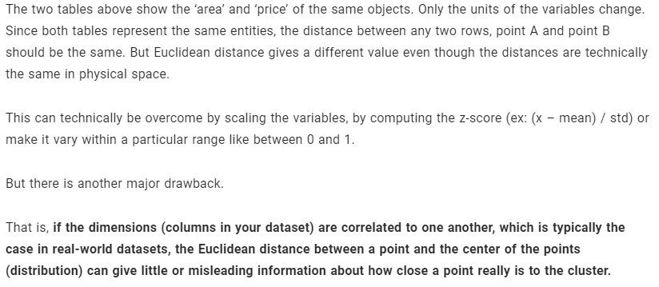
Problem 1

Slide 31
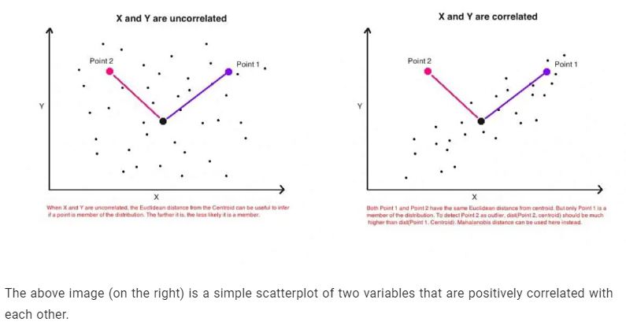
Problem 2
In daily life, when we talk about distance, we use the term "distance between point A and point B". It is used interchangeably with "length".
Both Mahalanobis distance and Euclidean distance are labeled as "distance", but they can also be used for things that are not "length". In Data Science , distance is sometimes used as an indicator of "A and B are similar".

Slide 32
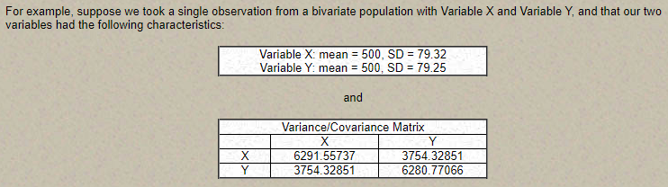
Mahalanobis distance: Example

Slide 33
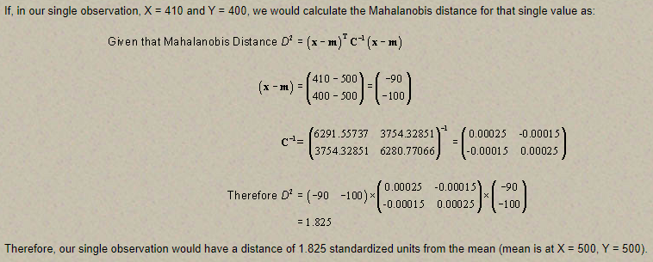
Mahalanobis distance: Example

Slide 34
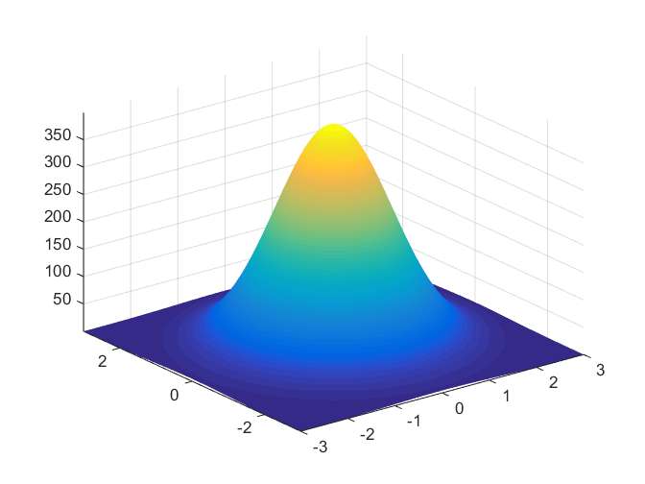
Multivariate normal distribution
A multivariate normal distribution is a vector in multiple normally distributed variables, such that any linear combination of the variables is also normally distributed.
The multivariate normal distribution is useful in analyzing the relationship between multiple normally distributed variables, and thus has heavy application to biology and economics where the relationship between approximately-normal variables is of great interest.

Slide 35
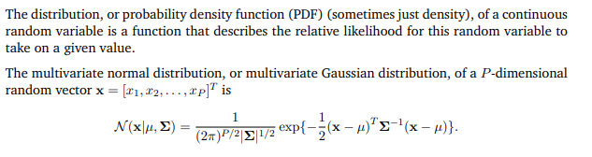
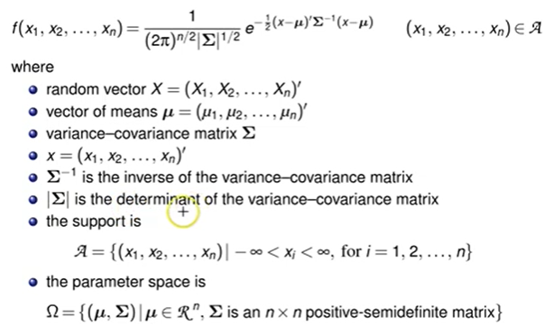
Multivariate normal distribution

Slide 36
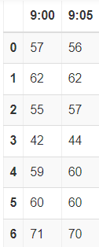
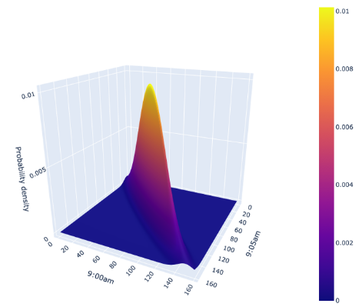
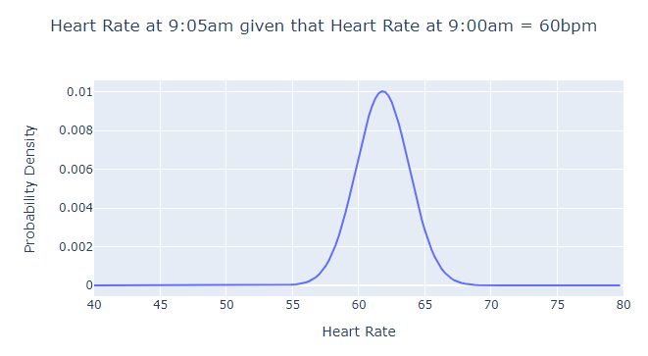
Example:
Imagine you want to measure two variables: your heart rate at 9:00am, and your heart rate at 9:05am in beats per minute (bpm). There is likely correlation between these two variables, i.e., your heart rate at 9:05am is probably pretty similar to your heart rate at 9:00am. You measure this data for 7 days, and you get the following data:

